Slide 1
ALV
Rajesh Mishra

Slide 2
What is ALV?
The ABAP List Viewer is a type of Control – a reusable piece of code for doing useful things on screen
ALVs can be used to write tables of data to the screen, handling all of the output processing automatically. This means that the developer does not have to deal with write statements, lining up columns, etc. The developer must select the data, and then the ALV does the rest.
An example of an ALV is SE16. If you view any table, and go to Settings / User Parameters, there is a choice of Display Mode: ALV list (block mode) looks much like a standard list, but has various new features, e.g:
Sorting by any number of columns in a specified order
Filtering
Column selection and ordering
Direct links to Excel and Word
Totals for numeric data
ALV grid has an updated look, and has the same advanced features as ALV list mode but with some additions, such as the ability to produce subtotals for numeric data, and also numerous display options. When Print Preview is selected, the display reverts to block mode.
All of these features are provided directly by the ALV, and can be used by any developer to produce any report, with little programming effort involved.

Slide 3
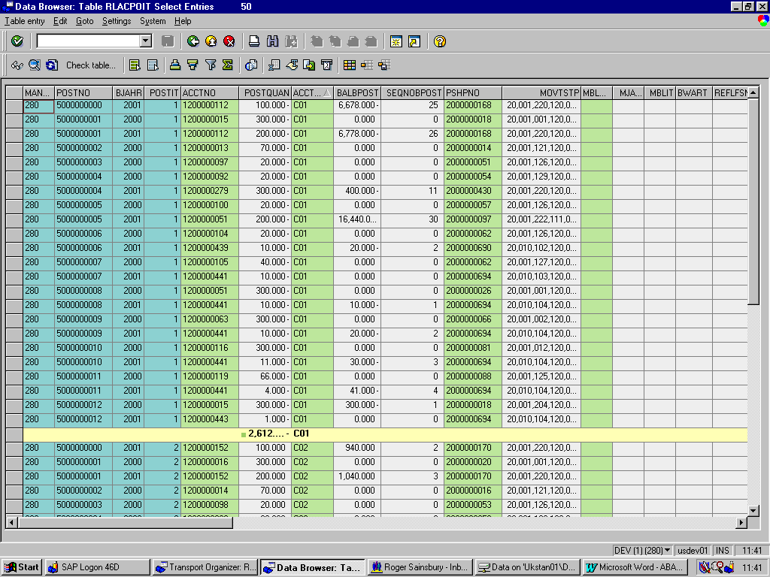
ALV - Snapshot

Slide 4
Sources of information in SAP
SAP Library Help
Details of how to use the new ALV features is provided in SAP Help:
Cross-Application Components / General Application Functions / SAP List Viewer (ALV): Classic.
Programming ALVs is also partly covered in the SAP Help – go to:
Basis Components / Basis Services and Communication Interfaces / SAP List Viewer / ALV Grid Control
The text is comprehensive, and explains how to use the new Object Oriented ABAP technology to create and use ALVs. Fortunately however, it is not necessary to understand OO ABAP to use ALVs. Most of this Help information is therefore not strictly relevant, with the possible exception of the section entitled ‘The Field Catalog’ – a concept which is explained below.
Development Class SLIS
All of the ALV functionality is located in one development class, SLIS. Although the ALV technology is Object Oriented, SAP have developed a range of function modules that handle this side of things, so it is possible to use ALVs without any knowledge of OO ABAP. The most powerful FMs seem to be located in two Function Module Groups: SALV and SLVC_FULLSCREEN. Some examples are:
Group SALV:REUSE_ALV_LIST_DISPLAYOutput a list in block modeREUSE_ALV_POPUP_TO_SELProduce a list in a Dialog Box, for the user to select fromREUSE_ALV_HIERSEQ_LIST_DISPLAYProduce a list from separate Header and Item data tablesGroup SLVC_FULLSCREEN:REUSE_ALV_GRID_DISPLAYOutput a list in an ALV GridREUSE_ALV_GRID_COMMENTARY_SETProduce a nice header for an ALV Grid
The SALV FMs are well documented in English; the SLVC_FULLSCREEN FMs are not documented in English until 4.6C, but are very similar to the SALV FMs anyway.
Furthermore, the SLIS class contains a vast array of example programs covering most aspects of using ALVs. The simplest example for a grid is BALVSD02_GRID; a slightly more complex version is BCALV_FULLSCREEN_DEMO. A block display version of the same program is BCALV_FULLSCREEN_DEMO_CLASSIC.
These programs and function modules can either be accessed directly through SE80.

Slide 5
Data Declaration / Selection
Data Declaration
In the Data Declarations, include the following statement:
type-pools: slis.
This gives the program access to all of the standard ALV data types.
Some internal tables / data structures that may be needed are as follows:
* Table of results
data: ts_output type standard table of t_output,
wa_output type t_output.
* Field Catalogue
data: ts_fieldcat type slis_t_fieldcat_alv,
wa_fieldcat type slis_fieldcat_alv.
* Headings
data: ts_header type slis_t_listheader,
wa_header type slis_listheader.
* Events
data: ts_events type slis_t_event,
wa_events type slis_alv_event.
* Sort order
data: ts_sort type slis_t_sortinfo_alv,
wa_sort type slis_sortinfo_alv.
* Layout settings
data: st_layout type slis_layout_alv.
The table of results is based on a bespoke structure, containing all fields that may need to be displayed to the user. If you were intending to use REUSE_ALV_HIERSEQ_LIST_DISPLAY, you would actually have two bespoke tables: header and item data.
The other tables and structures use templates from the type-pool SLIS. They must have these structures to be used in the ALV function modules.
  Data Selection
The selection screen definition and the selection process are as for any other report. Compile the results into the TS_OUTPUT table.

Slide 6
Field Catalogues
All types of ALV use a Field Catalogue of some description, and this should be defined next. This is a table, which describes the fields in TS_OUTPUT that will be passed to the FM to be output (e.g. metadata). This can be created in three ways:
Automatically – when you call the FM, you specify in I_STRUCTURE_NAME a dictionary structure that your internal table will be like, and the Function Module does the rest. The structure could be an SAP table (unlikely, as this can be viewed through SE16), or a structure. Using this method, it is not necessary to pass in a separate field catalogue, although if you do it will be merged with the Structure information.
Semi-Automatically – you create a Field Catalogue for a dictionary structure using FM REUSE_ALV_FIELDCATALOG_MERGE. You then manually change the entries, or add new ones. This is good if you only want to make a few changes to a standard structure.
Manually – you create your own Field Catalogue by setting the attributes of each field, and appending entries to the catalogue (e.g TS_FIELDCAT).
In practise, Manual creation is perhaps the most useful of these three methods. Look at the Function Module help for parameter IT_FIELDCAT to get a full description of each field in the field catalogue. There are many fields, but fortunately most of them do not need an entry. The most important ones are as follows:
FIELDNAME – the name of the field, as it is in the output table (required). E.g. KUNNR
REF_FIELDNAME & REF_TABNAME – use these two fields to specify what, in the data dictionary, the field is like. E.g. KUNNR and KNA1. If, as in this example, the fieldname is as it appears in the reference table, then you do not even have to specify REF_FIELDNAME at all.
In many cases, these three fields are all that is required for every entry in the Field Catalogue. The ALV FM then uses the Data Dictionary definition to get details such as length, data type, column headings and output settings. If the field is completely bespoke, you may need to provide:
DATATYPE – e.g. CHAR, NUMC
OUTPUTLEN – column width

Slide 7
Field Catalogues
If your field is bespoke, or if it is a description for another field, you may wish to give it texts and help from another data element. To do this, specify the data element using:
ROLLNAME
If the field is a currency amount or quantity, then you should provide details of the currency or unit of measure. This will ensure that the amounts are formatted correctly, and that any totals/subtotals are split by currency or by unit of measure. To do this, include this information in separate fields on TS_OUTPUT, and use the following options to point to them:
CFIELDNAME
QFIELDNAME
If the field is defined with reference to the data dictionary, then its column headings are taken from the texts defined for the data element. The text used depends on the width of the column. This approach should be used as much as possible: using standard texts provides a consistent approach, and on international implementations avoids the need for additional translations. If however the field is bespoke, or the standard headings are not appropriate, then they can be set manually with the following fields:
SELTEXT_L long text
SELTEXT_M medium text
SELTEXT_S short text
REPTEXT_DDIC heading
DDICTXT Use this to specify which of the 4 texts should be used by default
Field Order: by default fields are output as columns in the order in which they appear in the table. This order can be over-ridden using:
COL_POS
By default all fields are visible as columns. You can hide a field, but still have it available for the user to add, using:
NO_OUT
You may have field in the table, maybe a flag, which is used in the processing but is meaningless to the end-user. To stop such a field from being visible, define it as technical:
TECH
There are many other fields in the Field Catalogue table that can be used to define all aspects of formatting and display. See the help text for the Function Module for further information.
When defining the Field Catalogue, it is best to write out code for each field seperately:
clear wa_fieldcat.
wa_fieldcat-fieldname = 'RECREF'.
wa_fieldcat-ref_tabname = 'Z2RLBASEDAT'.
wa_fieldcat-col_pos = 6.
append wa_fieldcat to ts_fieldcat.
clear wa_fieldcat.
wa_fieldcat-fieldname = 'MANCODE'.
wa_fieldcat-ref_tabname = 'Z2RLBASEDAT'.
wa_fieldcat-col_pos = 21.
append wa_fieldcat to ts_fieldcat.
This is better than trying to use a subroutine, which can get very complicated due to the number of options available.

Slide 8
Layout Settings
Some of the most useful layout settings are:
ZEBRA – the table of results is displayed with striped colouring, making it much easier to read.
COLWIDTH_OPTIMIZE – with this option checked, each column is only as wide as its longest value, or its title. This means that the report is as compact as it can possibly be, which is usually a very good thing. Note that there is a slight bug in Grid mode: it only seems to optimise for the page you are on. However this problem does not occur in grid / print preview mode.
GET_SELINFOS – in Block mode (print preview for a Grid) the selection criteria can be displayed by hitting a blue information icon. A separate icon, which appears as standard, gives details of how many lines were selected – often useful information. All these details can be displayed on a separate header page, when printing the report.
GROUP_CHANGE_EDIT – if you sort a report by a column, you may well want to print the results starting on a new page for each new value. If this option is set you can do just that. You need to go to the Subtotals dialogue in block / print preview mode. Next to the sort options, you are able to request either an underline or a new page for each new value.

Slide 9
Sort Table
By default, an ALV will display data in the order in which it is provided. However you can define a different sort order, to be used by default, using the Sort table. The table can also be used to specify fields to subtotal by. Example code:
clear wa_sort.
wa_sort-spos = 1.
wa_sort-fieldname = 'PCVQTY'.
wa_sort-up = c_yes.
append wa_sort to ts_sort.

Slide 10
Events
Control can be returned to the calling program at various points – these are called events. The most common events are Function Module parameters, for example I_CALLBACK_TOP_OF_PAGE. The name of a subroutine can be provided for the event. When the event is reached, e.g. the processing starts writing out a new page of data, control returns to the calling program, and the subroutine is executed.
An alternative way to deal with events is to build a table of them:
call function 'REUSE_ALV_EVENTS_GET'
* EXPORTING
* I_LIST_TYPE = 0
importing
et_events = ts_events
exceptions
list_type_wrong = 1
others = 2.
if sy-subrc <> 0.
message id sy-msgid type sy-msgty number sy-msgno
with sy-msgv1 sy-msgv2 sy-msgv3 sy-msgv4.
endif.
clear wa_events.
wa_events-form = 'TOP_OF_PAGE'.
modify ts_events from wa_events
transporting form
where name = slis_ev_top_of_page.
The function module will provide entries in the table for all the possible events. Subroutine names can then be added where required.
When using events, it is important to define parameter I_CALLBACK_PROGRAM. This is the name of the program calling the ALV, and must be provided so that the ALV code can call the appropriate subroutine remotely. Unfortunately, it is not possible to specify SY-REPID directly here; so copy it to a variable and pass this instead.

Slide 11
Events
Events also offer the means to implement the ALV equivalent of Interactive Reporting. The two events required are:
i_callback_pf_status_set = 'SET_PF_STATUS'
i_callback_user_command = 'USER_COMMAND'
Create a GUI Status based on the standard ALV template. Add in the new options required, with appropriate OKCODES. The subroutine ‘SET_PF_STATUS’ will then simply set the GUI Status to the bespoke one, overriding the standard.
We then need to be able to process the bespoke OKCODES – this is what the ‘USER_COMMAND’ subroutine does. An example of the code is as follows:
form user_command using r_ucomm like sy-ucomm
rs_selfield type slis_selfield.
* Read line and get the UMI to select with, if possible:
if rs_selfield-tabindex > 0.
clear wa_output.
read table ts_output into wa_output
index rs_selfield-tabindex.
w_value = wa_output-zzumicur.
else.
message i010(ad) with text-i02.
exit.
endif.
case r_ucomm.
* Go to Basedata
when 'BASE'.
leave to list-processing.
perform base_data_report.
* Go to Change History
when 'CHAN'.
leave to list-processing.
perform change_history_report.
endcase.
endform. " USER_COMMAND
The R_UCOMM contains the OKCODE, ready for processing.
The RS_SELFIELD structure contains information about what was selected - so any changes can be applied to the correct line.
The structure also contains some Export parameters. For example if a user command causes data to be reselected (e.g. a Refresh button), marking RS_SELFIELD-REFRESH with an ‘X’ causes the ALV display to be refreshed.

Slide 12
Headings
The simplest way to provide a heading, is to pass in a text to parameter I_GRID_TITLE.
A more complex header can be built up in a Heading table. Each line in the table will appear as a separate line in the header; and 3 different fonts are available to distinguish between different types of information:
clear wa_header.
wa_header-typ = c_header.
wa_header-info = text-t01.
append wa_header to ts_header.
clear wa_header.
wa_header-typ = c_selection.
wa_header-key = p_text.
wa_header-info = l_text.
append wa_header to ts_header.
With the table of headings built, in the TOP_OF_PAGE subroutine call the following Function Module:
call function 'REUSE_ALV_COMMENTARY_WRITE'
exporting
it_list_commentary = ts_header.

Slide 13
Layout Variants
One of the key strengths of ALVs is the facility for users to change the report layout, and to store different layouts as variants. Variants can be user-specific, or global. The parameter I_SAVE can be set to determine what types of variants users are allowed to save. Typically this is going to be ‘A’ (all types), but there may be occasions where the business requires something different.
Having created some variants, one of them can be made the default, if the I_DEFAULT parameter is set. There can be a global default, and also a user-specific default, which takes precedence over the global one. If a default variant has been set up, the report will automatically be produced in that format.
If a number of different layouts exist, the user may want to choose which one to use on the selection screen. This could be especially important if the user needs to run the report as a background job. This can be done with the following code:
parameters: p_vari like disvariant-variant.
...
*-----------------------------------------------------------------------
* AT SELECTION-SCREEN EVENTS - validate user input
*-----------------------------------------------------------------------
at selection-screen on value-request for p_vari.
* popup F4 help to select a layout
clear: st_variant,
w_exit.
st_variant-report = sy-repid.
call function 'LVC_VARIANT_F4'
exporting
is_variant = st_variant
i_save = c_save
importing
e_exit = w_exit
es_variant = st_variant
exceptions
not_found = 1
others = 2.
if sy-subrc ne 0.
message id sy-msgid type sy-msgty number sy-msgno
with sy-msgv1 sy-msgv2 sy-msgv3 sy-msgv4.
else.
if w_exit is initial.
* set name of layout on selection screen
p_vari = st_variant-variant.
endif.
endif.
* Test if a specified layout exists
at selection-screen on p_vari.
clear st_variant.
if not ( p_vari is initial ).
move p_vari to st_variant-variant.
move sy-repid to st_variant-report.
call function 'LVC_VARIANT_EXISTENCE_CHECK'
exporting
i_save = c_save
changing
cs_variant = st_variant
exceptions
wrong_input = 1
not_found = 2
program_error = 3
others = 4.
if sy-subrc <> 0.
message id sy-msgid type sy-msgty number sy-msgno
with sy-msgv1 sy-msgv2 sy-msgv3 sy-msgv4.
endif.
endif.
When calling the function module, pass in ST_VARIANT to the IS_VARIANT parameter.

Slide 14
Call the Function Module
Example:
* Set prog name to current program
w_repid = sy-repid.
* Output data table to the screen using function module
call function 'REUSE_ALV_GRID_DISPLAY'
exporting
* I_INTERFACE_CHECK = ' '
* I_BYPASSING_BUFFER =
* I_BUFFER_ACTIVE = ' '
i_callback_program = w_repid
i_callback_pf_status_set = 'SET_PF_STATUS'
i_callback_user_command = 'USER_COMMAND'
* i_callback_top_of_page = 'ALV_TOP_OF_PAGE'
* I_CALLBACK_HTML_TOP_OF_PAGE = ' '
* I_CALLBACK_HTML_END_OF_LIST = ' '
* I_STRUCTURE_NAME =
* I_BACKGROUND_ID = ' '
* I_GRID_TITLE = text-t01
* I_GRID_SETTINGS =
is_layout = ts_layout
it_fieldcat = ts_fieldcat
* IT_EXCLUDING =
* IT_SPECIAL_GROUPS =
* IT_SORT =
* IT_FILTER =
* IS_SEL_HIDE =
* I_DEFAULT = 'X'
i_save = c_standard_and_user
* IS_VARIANT =
* IT_EVENTS =
* IT_EVENT_EXIT =
* IS_PRINT =
* IS_REPREP_ID =
* I_SCREEN_START_COLUMN = 0
* I_SCREEN_START_LINE = 0
* I_SCREEN_END_COLUMN = 0
* I_SCREEN_END_LINE = 0
* IT_ALV_GRAPHICS =
* IT_ADD_FIELDCAT =
* IT_HYPERLINK =
* IMPORTING
* E_EXIT_CAUSED_BY_CALLER =
* ES_EXIT_CAUSED_BY_USER =
tables
t_outtab = ts_output
exceptions
program_error = 1
others = 2
.
if sy-subrc <> 0.
message e010(ad) with text-e10.
endif.
There are many ALV options in addition to those described above – they are all covered in the ALV Function Module documentation.

Slide 15

Thank You

